Slide 1
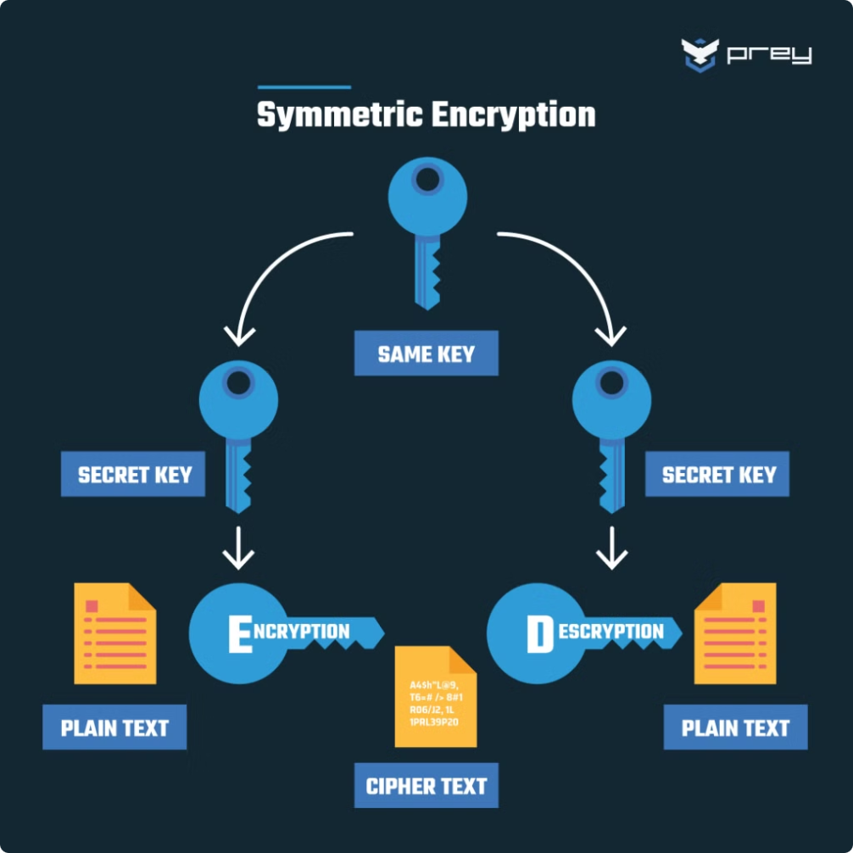
Text and File Encryption and Decryption Tool
This application provides robust data protection through AES-based encryption and decryption for both text and files, ensuring sensitive information remains secure. Featuring password protection and a user-friendly interface, it guards against unauthorized access and simplifies secure data handling.

Slide 2
Team
Aditya Kundu - 21CS011004
Anurag Karmakar- 21CS011021
Arpan Halder - 21CS011030
Biraj Naskar - 21CS011043
Debalina Ghosh - 21CS011045

Slide 3
Introduction
Securely encrypt and decrypt both text and files using AES (Advanced Encryption Standard) with a 256-bit key. Highlight its use in protecting sensitive information by converting it into an unreadable format, ensuring data confidentiality.
Text Encryption/Decryption: Allows users to input text and securely encrypt or decrypt it.
File Encryption/Decryption: Provides functionality to encrypt and decrypt files, making it suitable for a broader range of data types.
Password Protection: Uses a password-based key derived from hashing to ensure that only authorized users can encrypt or decrypt data.
Encryption Algorithm: Utilizes AES for encryption.

Slide 4
Key Functionalities:
1
Text Encryption and Decryption: Securely encrypt and decrypt textual data using AES with a 256-bit key, ensuring data confidentiality.
2
File Encryption and Decryption: Encrypt and decrypt files, making it versatile for handling various types of data beyond just text.
3
Password Protection: Utilizes a user-defined password, hashed with SHA-256, to generate a secure encryption key, ensuring that only authorized users can access the encrypted data.
4
Lockout Mechanism: Implements a lockout feature to prevent brute-force attacks by locking the user out after multiple failed password attempts, enhancing security.
5
Progress Bar for Processing: Displays a progress bar during encryption and decryption processes, providing users with visual feedback on ongoing operations.
6
Error Handling and Notifications: Provides clear error messages and notifications for invalid inputs, encryption/decryption failures, and file operation issues, ensuring a smooth user experience.

Slide 5
User Authentication:
Users must set a secure password following strict validation rules (minimum length, uppercase, lowercase, digit, and special character requirements).
The password is securely hashed with a salt using SHA-256 and stored for verification.
On login, the entered password is validated against the stored hashed password. Lockout mechanisms prevent brute force attacks by limiting retry attempts.
Data Encryption:
Working Principle :
For both text and files, the AES encryption algorithm in GCM mode is used. This mode ensures both confidentiality and integrity of data.
During encryption:
A secure key is derived from the user's password using SHA-256.
A random initialization vector (IV) is generated for AES.
Data is encrypted, and a unique tag is generated to validate the integrity during decryption.
The encrypted content, IV, and tag are encoded using Base64 for easy storage or sharing.
Data Decryption:
During decryption:
The user provides their password, which is validated to derive the decryption key.
The encoded encrypted data is decoded, and the IV, tag, and ciphertext are extracted.
AES-GCM ensures the ciphertext is decrypted only if the tag matches, guaranteeing integrity.
If any tampering or incorrect password is detected, decryption fails with appropriate error feedback.
Graphical User Interface (GUI):
A user-friendly interface built with Tkinter guides users through encryption and decryption tasks.
Features include:
Input fields for text or file selection.
Buttons for encrypting and decrypting text or files.
Progress bars for visual feedback during processing.
The GUI dynamically validates inputs, such as ensuring non-empty text or file selection.
File Handling:
Files are encrypted and saved with an additional .enc extension to distinguish them.
During decryption, the output file is saved with a _decrypted suffix to avoid overwriting the original file.
Security Features:
Enforced strong password policies and retry limits.
AES-GCM ensures both data confidentiality and integrity.
Salted hashing for password storage to defend against dictionary and rainbow table attacks.
Lockout periods reduce the risk of brute force password guessing.

Slide 6
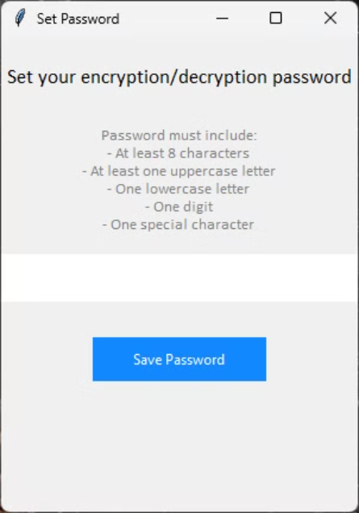
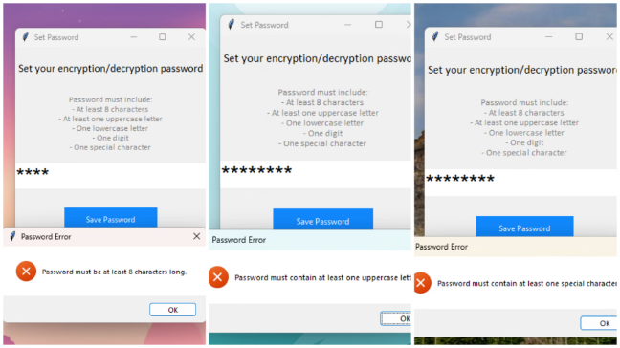
Screenshots :
Errors due to incorrect password strength validation
Validates password strength (minimum 8 characters, uppercase, lowercase, digit, and special character).
Set Password screen
Users set a secure password to access the application.
Passwords are hashed and salted for secure storage.

Slide 7
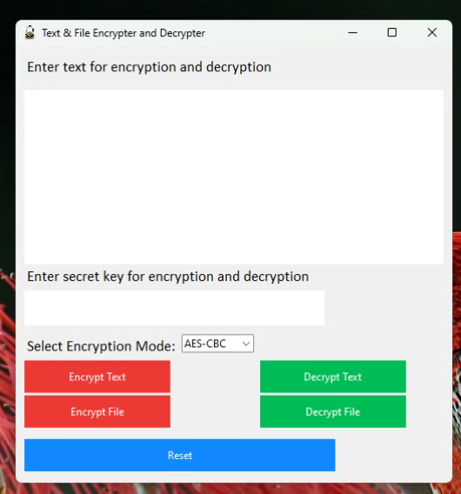
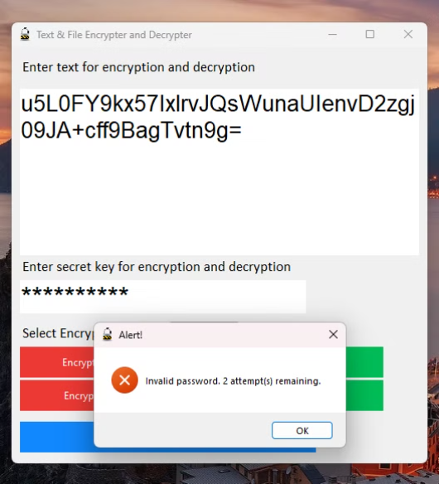
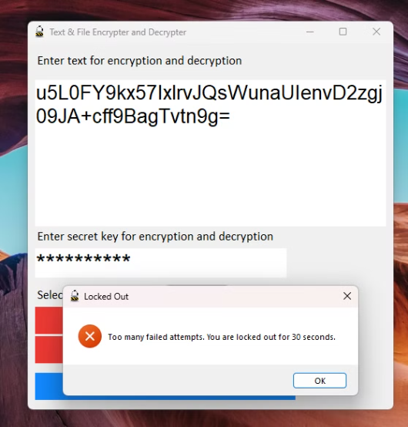
Screenshots :
Main screen
Locked out
Incorrect password
Developed using Tkinter, offering a clean and intuitive graphical interface.
After 3 failed password attempts, the user is locked out for 30 seconds.
Allows 3 attempts to enter the correct password.

Slide 8
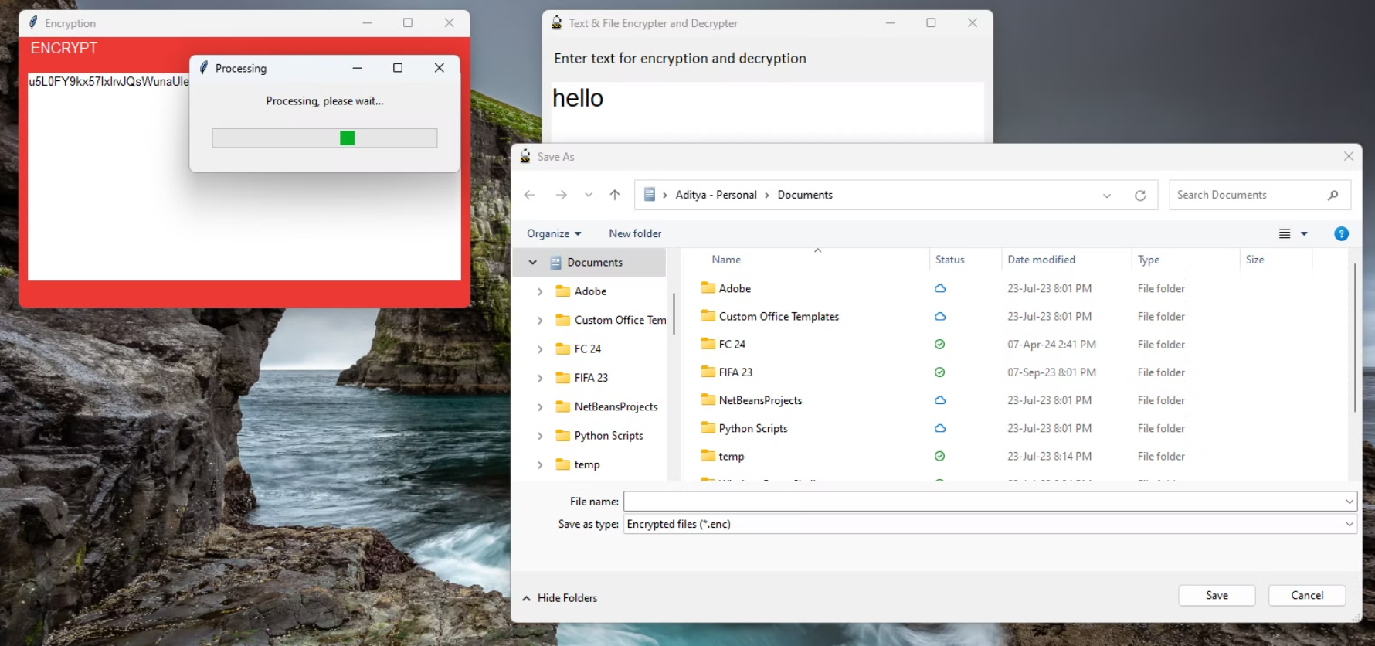
Screenshots :
Text Encryption and File Encryption
Encrypts user-provided text using a secure password.
Encrypts and decrypts files of any type.
Encrypted files are saved with a .enc extension, while decrypted files are restored to their original format.

Slide 9
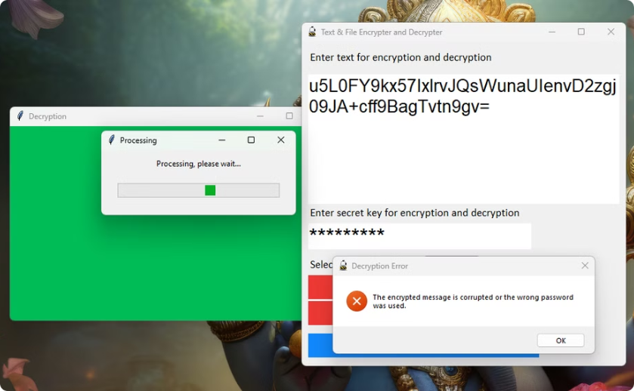
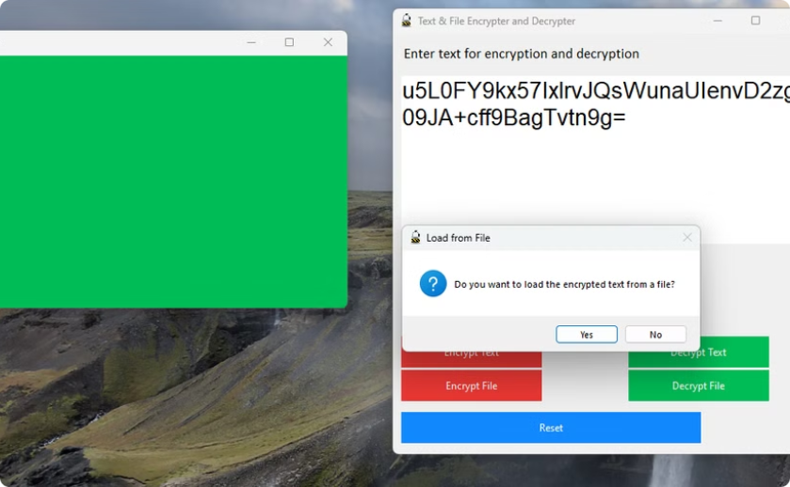
Screenshots :
Integrity Verification
Load encrypted text from a file
Checks if the encrypted message or file is corrupted during decryption.
While decrypting there is also an option to load an encrypted file (.enc file) from local disk or manually enter the encrypted text to the textbox to decrypt.
Ensures that only valid encrypted data can be decrypted successfully.

Slide 10
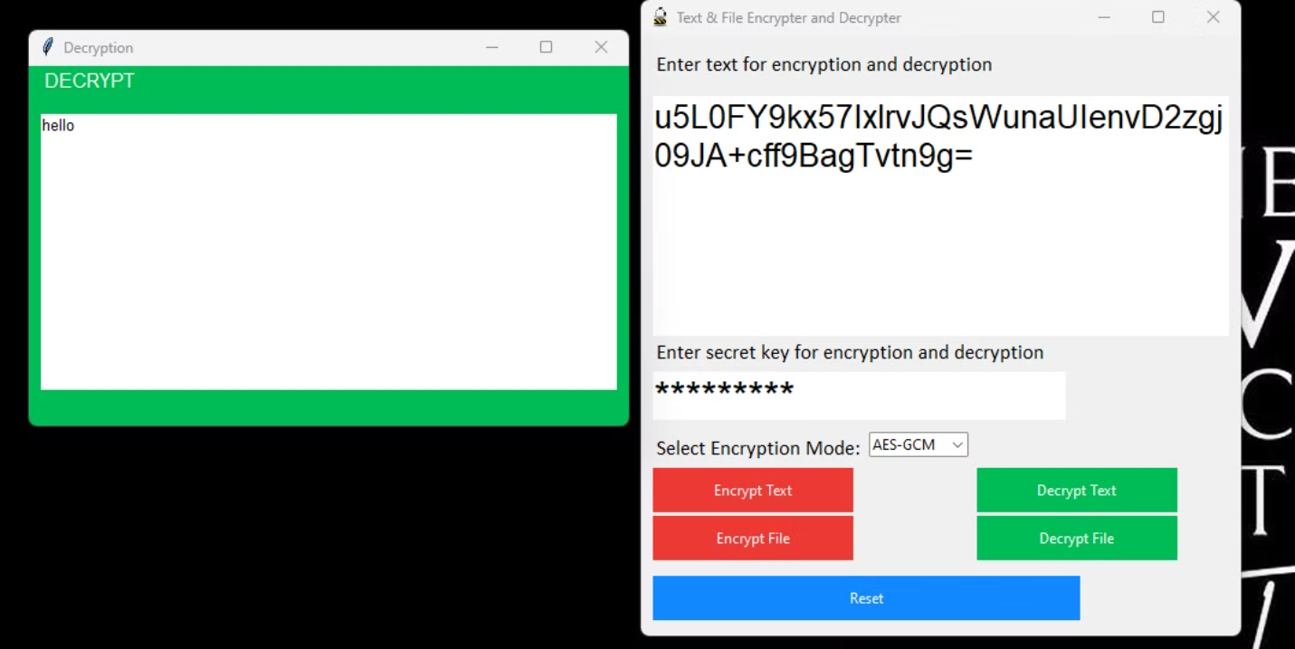
Screenshots :
Text Decryption
Encrypted files are saved with a .enc extension, while decrypted files are restored to their original format.

Slide 11
Conclusion
1. Enhanced Data Security:
The application effectively safeguards sensitive information by using AES with a 256-bit key, providing strong encryption and ensuring data confidentiality.
2. User Control and Customization:
Password-based key generation allows users to create secure, personalized encryption keys, enhancing control over data security.
3. Versatile Functionality:
Supports both text and file encryption/decryption, making it a versatile tool for various data protection needs.
4. Robust Error Handling:
Incorporates comprehensive error handling and user notifications to manage issues like invalid inputs and encryption/decryption failures, ensuring a smooth user experience.
5. Security Measures:
Includes a lockout mechanism to prevent unauthorized access through repeated failed attempts, adding an extra layer of security.

Slide 12
References
Python Documentation
PyCryptodome Library
AES Encryption
SHA-256 Hashing
Crypto.Random Module
Tkinter Documentation
W. Stallings, Cryptography and Network Security: Principles and Practices, Prentice-Hall of India.
J. Menezes, P. C. van Oorschot, and S. A. Vanstone, Handbook of Applied Cryptography

